Slide 1


Brayan D. Hernandez Github: BrayanDH
12/02/2023

Slide 2

Outline
Executive Summary
Introduction
Methodology
Results
Conclusion
Appendix

Slide 3
Executive Summary
Summary of methodologies
First, I gathered data on successful SpaceX landings from both the public SpaceX API and the SpaceX Wikipedia page. Then, I added a new column called 'class' to label the successful landings. Using SQL, visualization tools like folium maps and dashboards, I explored the data to gain insights. Next, I selected relevant columns to be used as features and converted all categorical variables into binary using one hot encoding. To prepare the data for machine learning models, I standardized it and used GridSearchCV to identify the best parameters for the models. Finally, I visualized the accuracy scores of all the models.
Summary
I developed four different machine learning models: Logistic Regression, Support Vector Machine, Decision Tree Classifier, and K Nearest Neighbors. All models showed comparable results with an accuracy rate of approximately 83.33%. However, all the models over-predicted the successful landings. To improve model determination and accuracy, it is necessary to collect more data.

Slide 4
Introduction
Project background
Space X has disrupted the commercial space industry with their competitive pricing, charging only $62 million compared to the industry average of $165 million USD. One of the key reasons for their success is their ability to recover a significant portion of their rocket (Stage 1) after each launch. As a result, other companies like Space Y are looking to compete with Space X in the commercial space race.
Problems and answers
We have been tasked by Space Y to develop a machine learning model that can predict the success of Stage 1 rocket recovery.

Slide 5

Section 1

Slide 6
Methodology
Executive Summary
Data collection methodology:
I merged the data obtained from the public SpaceX API and the SpaceX Wikipedia page to create a combined dataset.
Perform data wrangling
The data was classified by labeling true landings as successful and all others as unsuccessful.
Perform exploratory data analysis (EDA) using visualization and SQL
Perform interactive visual analytics using Folium and Plotly Dash
Perform predictive analysis using classification models
The models were fine-tuned using GridSearchCV.

Slide 7
Data Collection
To obtain the necessary data for the project, we utilized two different approaches: API requests from the public SpaceX API and web scraping data from a table within SpaceX's Wikipedia entry. The SpaceX API provided a wealth of information on each flight, including Flight Number, Date, Booster Version, Payload Mass, Orbit, Launch Site, Outcome, Flights, GridFins, Reused, Legs, Landing Pad, Block, Reused Count, Serial, Longitude, and Latitude.
On the other hand, the Wikipedia table offered valuable data on Flight Number, Launch Site, Payload, Payload Mass, Orbit, Customer, Launch Outcome, Version Booster, Booster Landing, Date, and Time.
The data was collected by combining information from both sources. The following slide will demonstrate the data collection process via the API flowchart, while the subsequent slide will show the data collection process via web scraping flowchart..

Slide 8
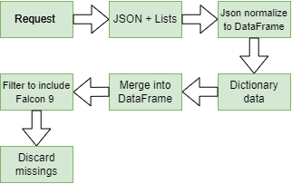
Data Collection – SpaceX API
Space X API Data
GitHub:
https://github.com/BrayanDH/Applied_Data_Science_Capstone/blob/master/1-Introduction/1.1-spacex-data-collection-api.ipynb
Imputate missing

Slide 9
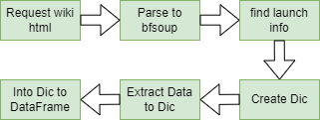
Data Collection - Scraping
Present your web scraping process using key phrases and flowcharts
GitHub:
https://github.com/BrayanDH/Applied_Data_Science_Capstone/blob/master/1-Introduction/1.2-webscraping.ipynb

Slide 10
Data Wrangling
We devised a method of creating a training label based on the landing outcomes of the missions, whereby the label is set to 1 for successful landings and 0 for failures. The outcome column, which had two components, 'Mission Outcome' and 'Landing Location,' was used to generate the new training label column called 'class.' A value of 1 was assigned to 'class' if the 'Mission Outcome' was True, indicating a successful landing, and 0 otherwise. We mapped the values as follows: True ASDS, True RTLS, and True Ocean were all set to 1, whereas None None, False ASDS, None ASDS, False Ocean, and False RTLS were set to 0. This approach enabled us to accurately classify the landing outcomes of each mission and provide valuable insights into the success rates of SpaceX's rocket launches.
Github: https://github.com/BrayanDH/Applied_Data_Science_Capstone/blob/master/1-Introduction/1.3-spacex-Data%20wrangling.ipynb

Slide 11
EDA with Data Visualization
We conducted an exploratory data analysis on several key variables, including Flight Number, Payload Mass, Launch Site, Orbit, Class, and Year. By analyzing these variables, we were able to gain a deeper understanding of the relationships between them and how they impact the success rates of SpaceX's rocket launches.
Plots To identify relationships between variables that could be used to train our machine learning model, we employed a variety of visualization techniques, including scatter plots, line charts, and bar plots. Specifically, we examined the following relationships: Flight Number vs. Payload Mass, Flight Number vs. Launch Site, Payload Mass vs. Launch Site, Orbit vs. Success Rate, Flight Number vs. Orbit, Payload vs Orbit, and Success Yearly Trend.
By analyzing the patterns and trends in these visualizations, we were able to identify correlations and insights that would be useful in our subsequent modeling efforts.
GitHUb: https://github.com/BrayanDH/Applied_Data_Science_Capstone/blob/master/2-EDA/2.2-eda-dataviz.ipynb

Slide 12
EDA with SQL
Using bullet point format, summarize the SQL queries you performed
We loaded our dataset into an IBM DB2 Database and used SQL Python integration to query the data.
Our queries were designed to gain a deeper understanding of the dataset, and we retrieved information on a variety of topics, including launch site names, mission outcomes, customer payload sizes, booster versions, and landing outcomes. By carefully analyzing these queries, we were able to extract valuable insights and patterns that would be instrumental in our subsequent data analysis and modeling work.
GitHub: https://github.com/BrayanDH/Applied_Data_Science_Capstone/blob/master/2-EDA/2.1-eda-sql-coursera.ipynb

Slide 13
Build an Interactive Map with Folium
Folium maps were used to mark Launch Sites, successful and unsuccessful landings, and a proximity example to key locations such as Railway, Highway, Coast, and City. This provides a comprehensive understanding of the geographic distribution of launch sites and successful landings, as well as the relationship between launch sites and key locations.
The maps also help visualize the importance of proximity to these key locations in determining the suitability of a launch site.
GitHub:
https://github.com/BrayanDH/Applied_Data_Science_Capstone/blob/master/3-Interactive%20Visual_Analytics_and_Dashboard/3.1-launch_site_location.ipynb

Slide 14
Build a Dashboard with Plotly Dash
The dashboard consists of a pie chart and a scatter plot that can be interacted with.
The pie chart displays the distribution of successful landings across all launch sites by default, but can be clicked to display the success rates of individual launch sites instead.
The scatter plot has two options: viewing all launch sites or an individual site and adjusting the payload mass via a slider that ranges from 0 to 10000 kg.
The pie chart is used to gain an overview of launch site success rates while the scatter plot allows for a closer look at how success rates vary based on factors such as launch site, payload mass, and booster version category.
GitHub:
https://github.com/BrayanDH/Applied_Data_Science_Capstone/blob/master/3-Interactive%20Visual_Analytics_and_Dashboard/spacex_dash_app.py

Slide 15
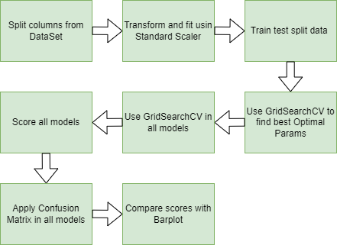
Predictive Analysis (Classification)
Github:
https://github.com/BrayanDH/Applied_Data_Science_Capstone/blob/master/4-Predictive_Analysis/SpaceX_Machine%20Learning%20Prediction_Part_5.ipynb

Slide 16
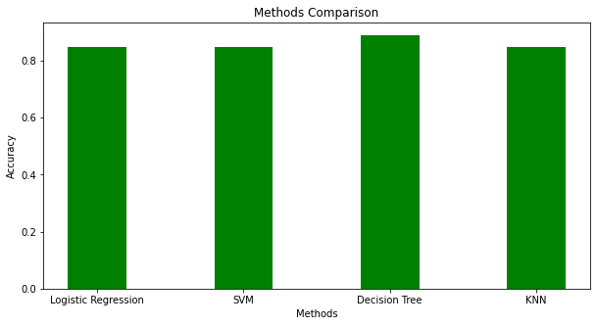
Results
This is a sneak peek of the Methodology Comparison section. The next slides will display a preview of the Methodology Comparison results, followed by the performance of our model with an accuracy of approximately 88%.

Slide 17

Section 2

Slide 18
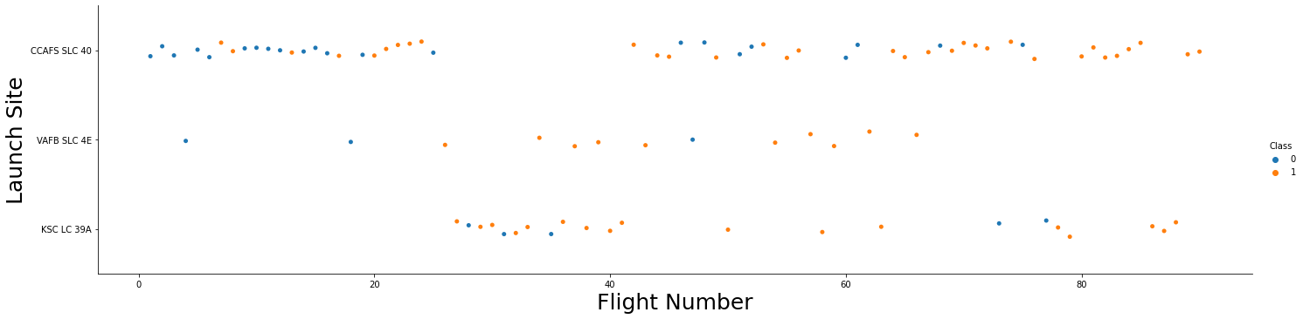
Flight Number vs. Launch Site
The chart indicates a positive trend in success rate as Flight Number increases, with a notable improvement around Flight 20. The data also shows that CCAFS is the primary launch site with the highest number of launches.
-Blues indicates successful launch
-Orange indicates unsuccessful launch

Slide 19
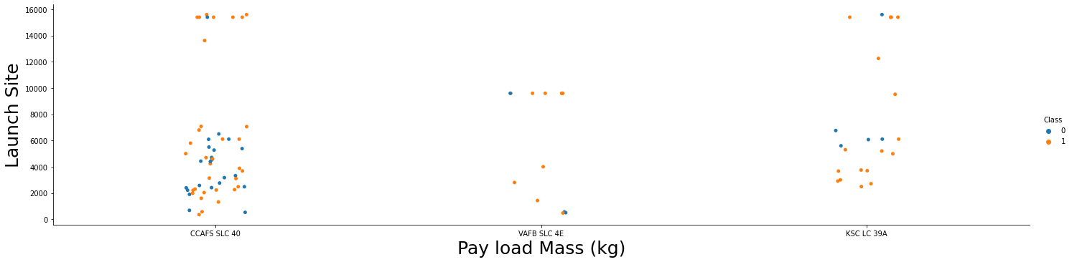
Payload vs. Launch Site
The distribution of payload mass is skewed to the right, with a majority of the payloads falling between 0-6000 kg. Furthermore, it appears that different launch sites have different typical payload masses, which may be due to the varying mission objectives of each launch site.
-Blues indicates successful launch
-Orange indicates unsuccessful launch

Slide 20
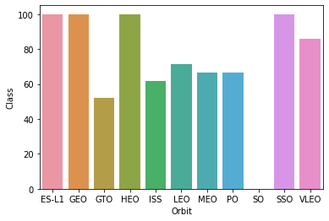
Success Rate vs. Orbit Type
ES-L1 (1), GEO (1), HEO (1) all have a perfect success rate (sample sizes indicated in parentheses). SSO (5) has also achieved a perfect success rate, while VLEO (14) has a respectable success rate and has made numerous attempts. On the other hand, SO (1) has a 0% success rate, and GTO (27) has the largest sample size but only around a 50% success rate.

Slide 21
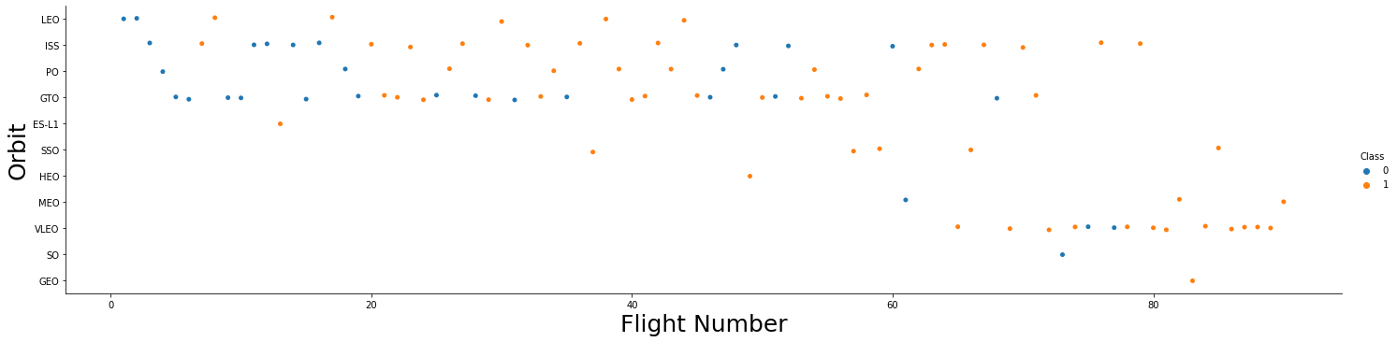
Flight Number vs. Orbit Type
Over time, SpaceX's preference for launch orbits seems to have changed with flight number. This preference appears to correlate with launch outcome. Initially, SpaceX focused on LEO orbits, which saw moderate success. However, in recent launches, they have returned to VLEO orbits. Interestingly, SpaceX seems to perform better in lower orbits or Sun-synchronous orbits
-Blues indicates successful launch
-Orange indicates unsuccessful launch

Slide 22
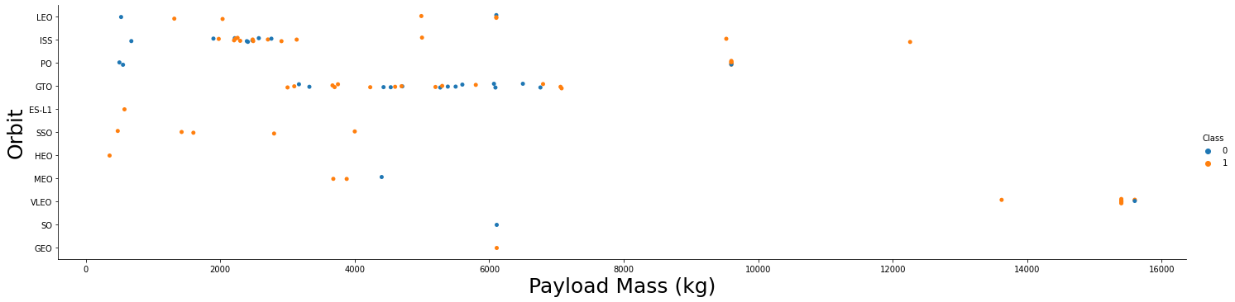
Payload vs. Orbit Type
There appears to be a correlation between payload mass and orbit.
LEO and SSO orbits have lower payload mass on average.
On the other hand, VLEO, which has a higher success rate, has payload mass values that mostly fall in the higher end of the range.
-Blues indicates successful launch
-Orange indicates unsuccessful launch

Slide 23
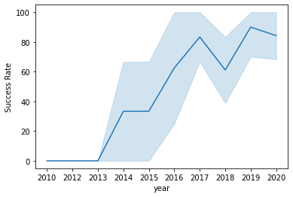
Launch Success Yearly Trend
Over the years since 2013, there has been a general trend of success rate increase, except for a slight dip in 2018. The recent years show a success rate of around 80%. The 95% confidence interval is shown as light blue shading.

Slide 24
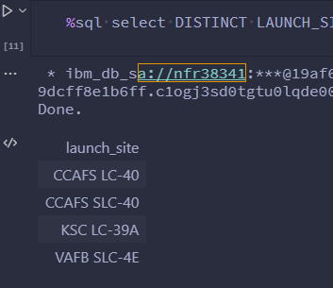
All Launch Site Names
Retrieve distinct launch site names from database.
There seems to be an inconsistency with CCAFS SLC-40 and CCAFS SLCSSLC-40, which may represent the same launch site due to data entry errors.
The previous name for CCAFS SLC-40 was CCAFS LC-40. Therefore, there are only three unique launch site values: CCAFS SLC-40, KSC LC-39A, and VAFB SLC-4E.

Slide 25
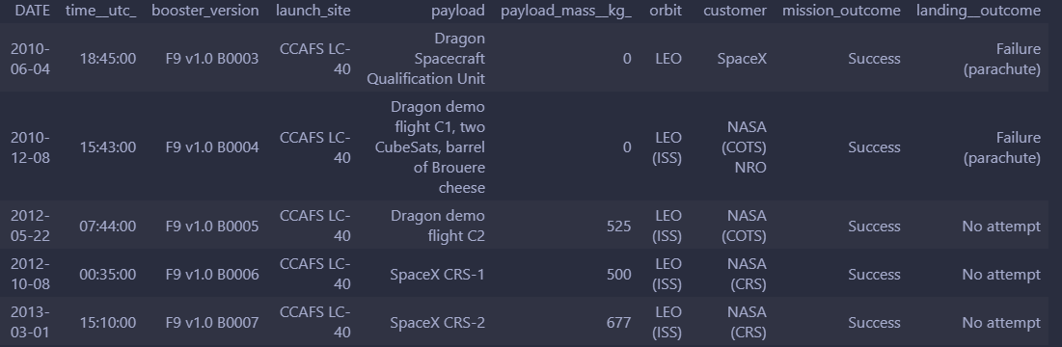
Launch Site Names Begin with 'CCA'
Retrieve a list of launch sites from the database and filter them to only show those starting with the letters "CCA" in the name. Display the launch site name, the number of launches from that site, and the success rate of those launches. Sort the list in descending order by the number of launches.

Slide 26
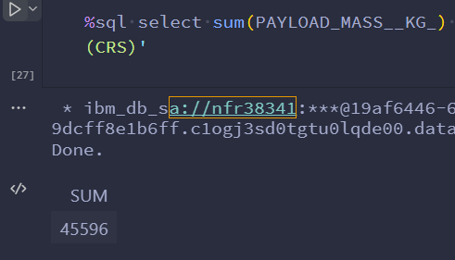
Total Payload Mass
The following SQL query calculates the weight in kilograms of payloads launched to the International Space Station, with a breakdown by CRS mission and NASA customer. This information provides insights into the types of payloads being sent to the ISS and how they are being delivered.

Slide 27
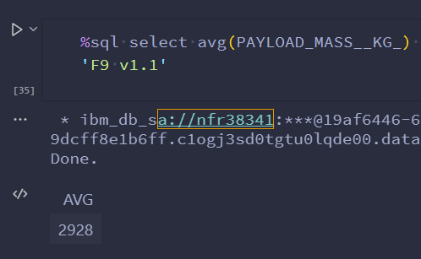
Average Payload Mass by F9 v1.1
Analyzing data from launches that utilized the F9 v1.1 booster version, we found that the average payload mass was relatively low compared to other launches in our dataset. It seems that this booster version was used primarily for lighter payloads.

Slide 28
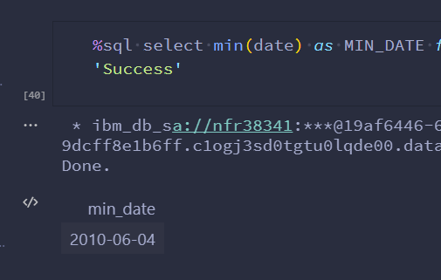
First Successful Ground Landing Date
This query displays the earliest date recorded for a successful launch.

Slide 29
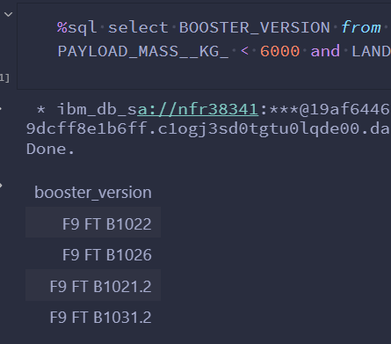
Successful Drone Ship Landing with Payload between 4000 and 6000
Using this query, we can identify the four booster versions that have successfully landed on drone ships with a payload mass falling between 4000 and 6000 kg (not including the boundaries). These are the real workhorses of SpaceX's fleet, powering some of their most critical missions with precision and reliability.

Slide 30
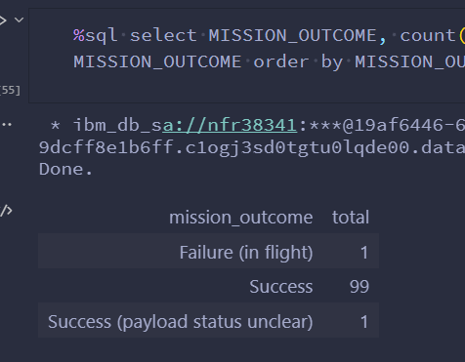
Total Number of Successful and Failure Mission Outcomes
Query the database to get a breakdown of mission outcomes.
SpaceX has a remarkably high success rate of nearly 99% in achieving mission objectives, indicating that most landing failures are deliberate. Notably, there was one launch with an unclear payload status and one unfortunate mid-flight failure.

Slide 31
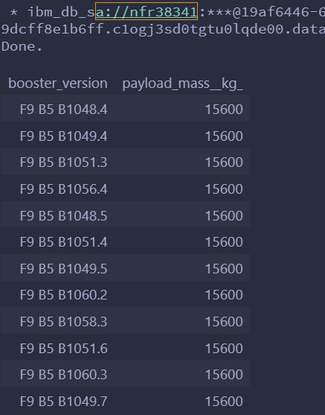
Boosters Carried Maximum Payload
This query shows the booster versions that transported the heaviest payload mass of 22000 kg.
All these boosters were F9 B5 B10xx.x, suggesting that the payload mass is closely related to the booster version utilized.

Slide 32
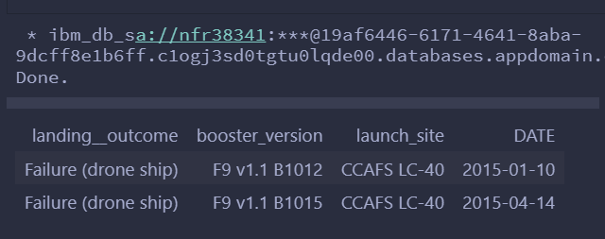
2015 Launch Records
This query displays for launches that used the booster version F9 v1.1 and landed successfully on an autonomous spaceport drone ship in 2015.
There were six successful landings that met these criteria.

Slide 33
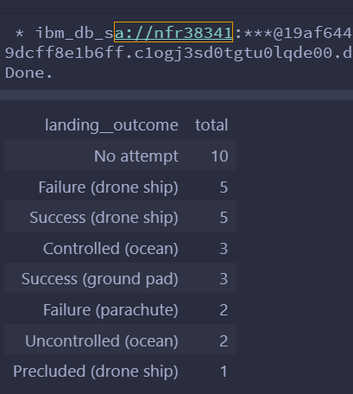
Rank Landing Outcomes Between 2010-06-04 and 2017-03-20
Query successful landings between June 4, 2010 and March 20, 2017, and return the landing outcome, landing location (drone ship or ground pad), and launch site.

Slide 34

Section 3

Slide 35
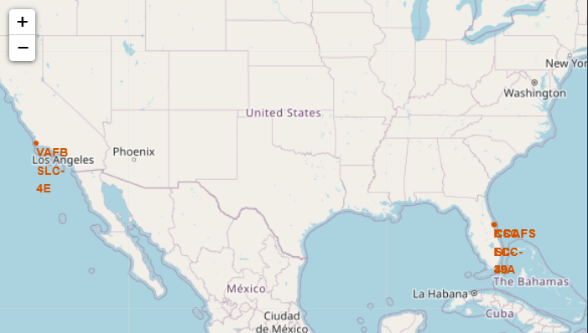
Folium Map Launch Site location
On the left map, launch sites are displayed relative to the US map. The right map, on the other hand, focuses on the two launch sites in Florida, which are located in close proximity to each other. Interestingly, all of the launch sites are situated near the ocean.

Slide 36
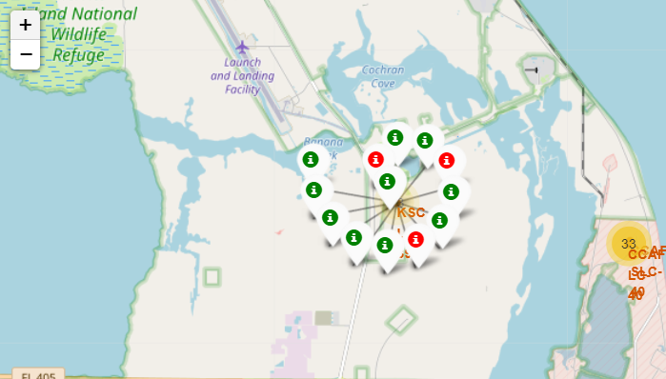
Color launch markets
On the interactive Folium map, clusters can be clicked to view detailed information on individual landings, including successful landings (green icon) and failed landings (red icon).

Slide 37
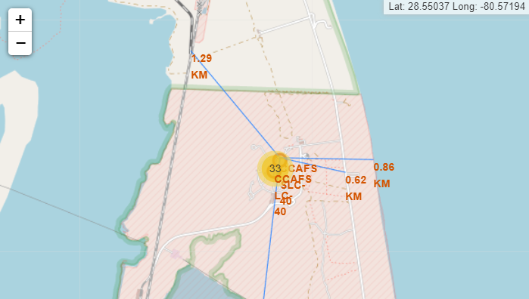
Location Proximities
Launch sites are strategically located near railways and highways for efficient supply transportation and easy access for human transport. In addition, they are situated close to coasts for easy access to ocean launch trajectories and to minimize risk of launch failures impacting densely populated areas. Thus, launch sites are located in areas that are relatively far from cities to ensure that any rocket debris from a launch failure lands in the sea.

Slide 38

Section 4

Slide 39
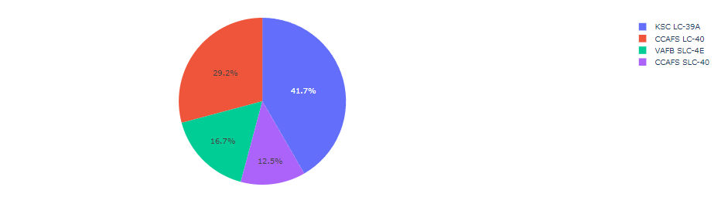
Total success launches by site
This visualization displays the distribution of successful rocket landings across different launch sites. CCAFS SLC-40, formerly known as CCAFS LC-40, and KSC have the same number of successful landings, but most of them were achieved before the name change. VAFB, on the other hand, has the lowest number of successful landings. This could be attributed to a smaller sample size and the increased difficulty of launching on the west coast.

Slide 40

Total Success Launches for Site one site
Total Success Launches for Site CCAFS LC-40, this site have a highest success rate

Slide 41
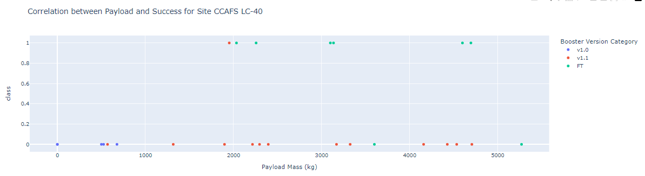
Payload Mass vs. Success vs. Booster Version comparative
The Plotly dashboard allows for selection of payload range, but it is limited to 0-10000 instead of the maximum payload of 15600 kg. The scatter plot displays successful landings as class 1 and failures as class 0. The plot also takes into account the booster version category as color and the number of launches as point size.

Slide 42

Section 5

Slide 43
Classification Accuracy
We can see that the model with the highest precision is the Decision Tree, as it achieves a precision of approximately 0.88.

Slide 44
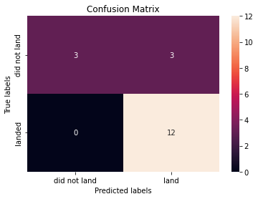
Confusion Matrix
The models correctly predicted 12 successful landings, but also predicted 3 unsuccessful landings that turned out to be successful (false negatives). Additionally, the models wrongly predicted 3 successful landings when the true label was unsuccessful (false positives). Overall, the models tend to overestimate the number of successful landings.

Slide 45
Conclusions
Our objective is to develop a machine learning model for Space Y to compete with SpaceX in predicting when Stage 1
We gathered data from a public SpaceX API and scraped the SpaceX Wikipedia page, created labels, and stored the data in a DB2 SQL database. A visualization dashboard was also created.
The machine learning model we developed has an accuracy of 89%.
Collecting more data can further enhance the accuracy and determine the best machine learning model.

Slide 46
Appendix
Dear Instructors and Coursera Team,
I would like to express my sincere gratitude for the invaluable knowledge and skills that I have gained through your courses. Your dedication, expertise, and support have been instrumental in shaping my understanding of various subjects and enhancing my career prospects. Thank you for providing high-quality education and making it accessible to everyone around the world
Git repo url:
https://github.com/BrayanDH/Applied_Data_Science_Capstone

Slide 47


